Slide 1
Combating Dirty Data using Data Virtualization
Author: Omkar Vilas Sawant
Presented by: Sarwasvi Ingoley (2021004)

Slide 2
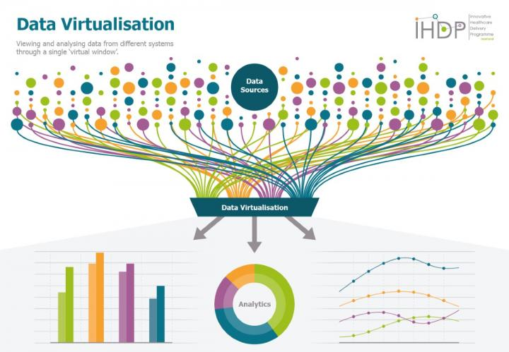
Contents
Introduction
Problem Definition
Proposed work
Data Virtualization
Conclusion
What will I implement
References

Slide 3
Introduction
Data has now become the DNA of any entity in the modern age.
During this course of development, the complexity to handle this data has also increased and is now creating data bottlenecks in various areas.
The complexity of the current systems has increased due to the interconnected nature of widely distributed systems which share data. This development resulted in data explosion and all kinds of data started flowing into the system.
Dirty Data: The data that is irrelevant, incomplete, absurd, insignificant or erroneous

Slide 4
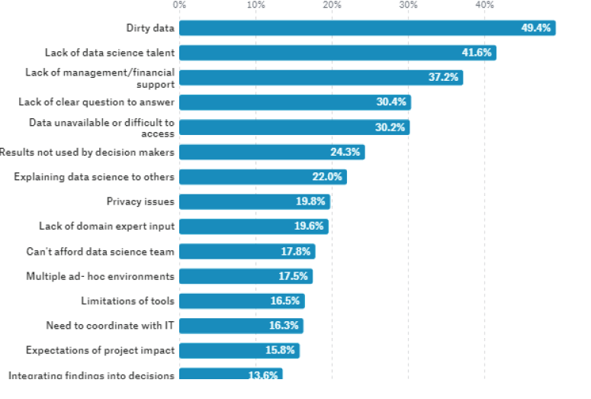
Fig: Data Science problem

Slide 5
Problem Definition
Increased Data formats: Data is now represented in various forms like structured, semi-structured and unstructured formats
Longer Data processing Cycles: Due to garbage data, the data processing cycles have increased
Reduced System Availability: Multiple systems have to be connected to since the data is scattered in them
Growing data bottlenecks: Data bottlenecks occur due to poor quality of data are paralyzing the organization’s decision making capabilities due to which they are losing revenues and market share

Slide 6
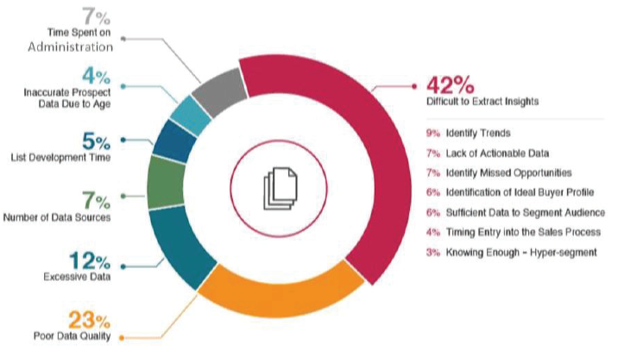
Fig: Dirty Data Segmentation

Slide 7
Proposed Work
We can solve the above defined problems by integrating Data Clarity and Data Virtualization
Data Clarity: The process which is used to transform the raw data into information, by filtering the various aspects in it is known as data cleansing or Data Clarity
Data Virtualization

Slide 8
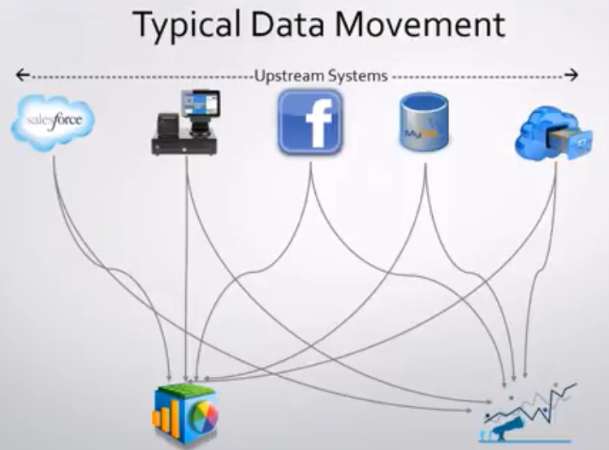
Data Virtualization
Fig: A typical system without data virtualization

Slide 9
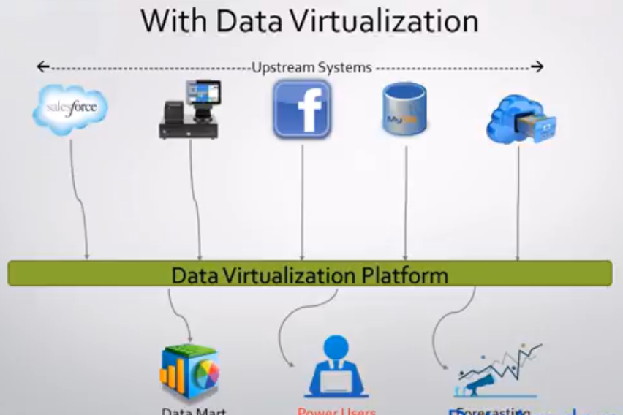
Data Virtualization
Data Virtualization combines disparate data sources into a single “virtual” layer that provides integrated data services to consuming applications or users in real time
Fig: A system with
data virtualization

Slide 10
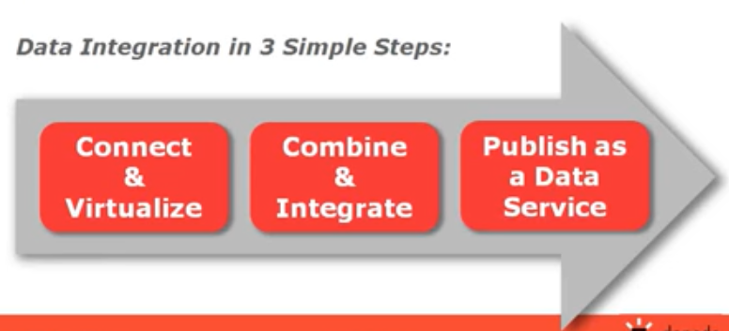
Data Virtualization
Fig: Data Integration

Slide 11
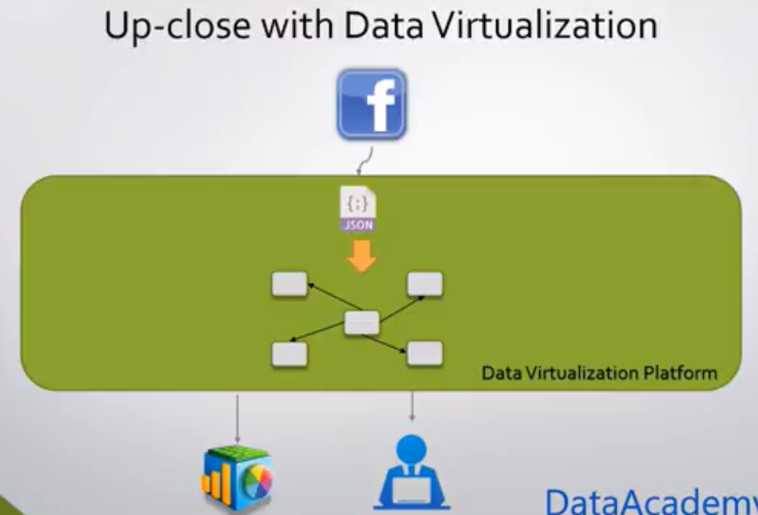

Slide 12
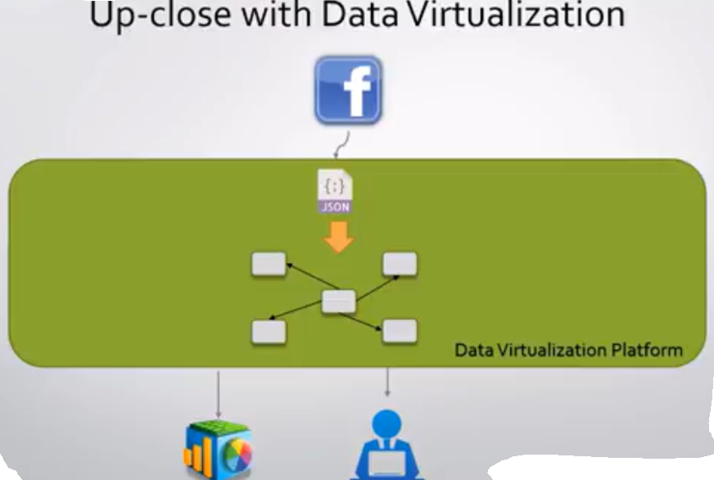

Slide 13
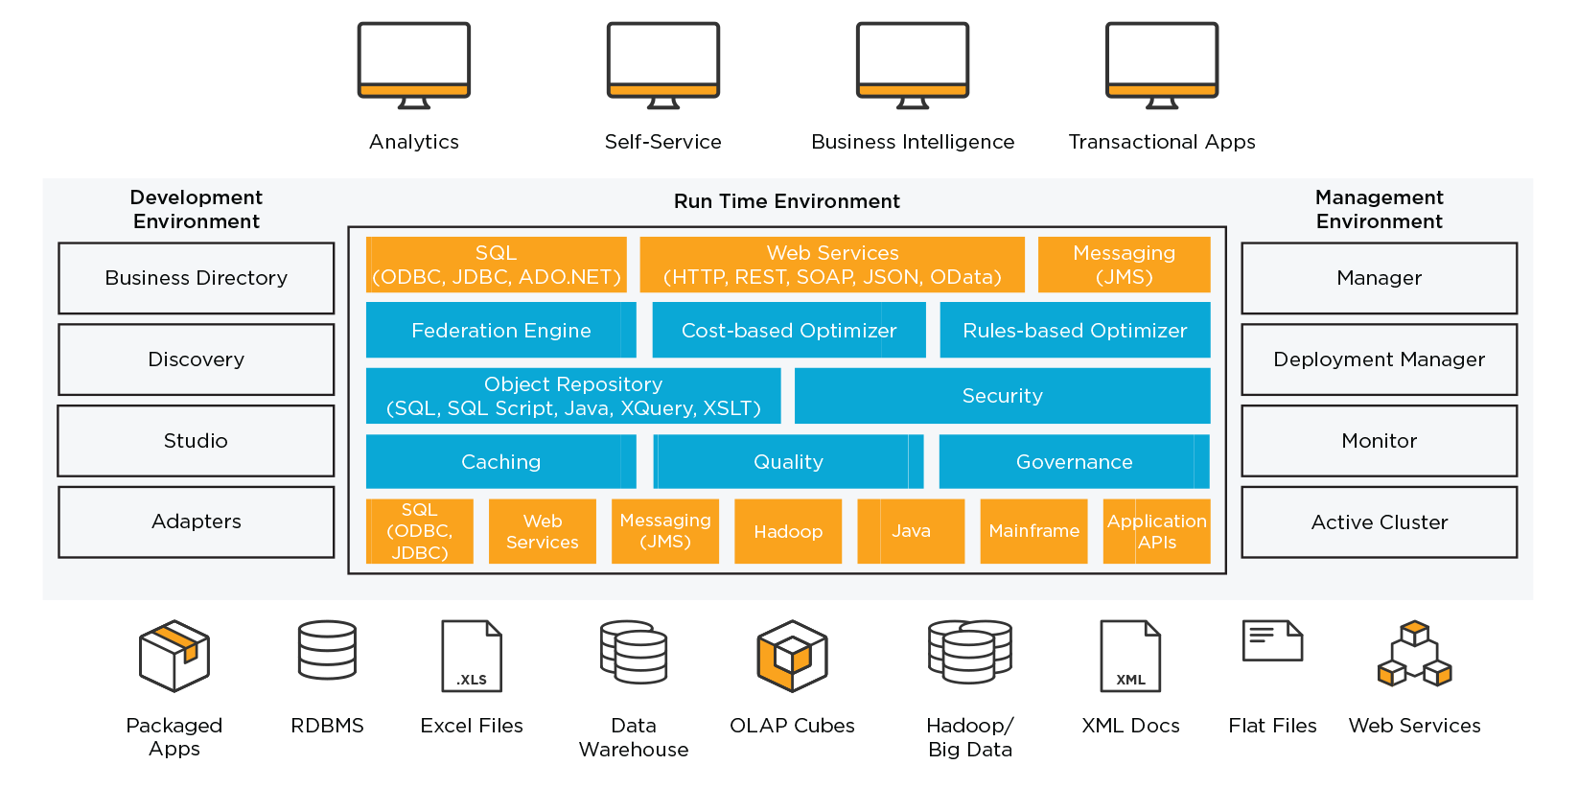
Data Virtualization Architecture

Slide 14
Data Virtualization
We create a virtual data layer which carries out the task of:
  Combining them with disparate data sources
  Cleansing the data
  Transforming it into desired format
  It provides data abstraction and makes systems less complicated. Hence avoiding data garbage

Slide 15
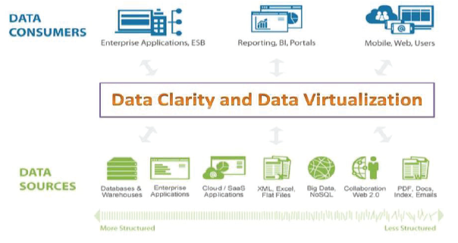
Fig: Data Clarity and Data Virtualization

Slide 16
Conclusion
Thus, Data virtualization provides a virtual layer on top of all of your data storage systems so you can easily connect them even if they are in different data storage systems.
With data virtualization, you can connect data across an organization in one central place without duplicating data into a data warehouse.
This provides a large opportunity in terms of cost savings as well as reducing technical work.
The problems pertaining to dirty data can be resolved with greater efficiency

Slide 17
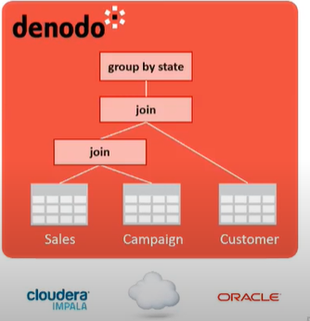
What will I implement?
Performing data virtualization using Denodo Platform.
Taking data from different data sources:
  MySQL (structured database)
  Excel (unstructured database)
  SoAP Webservice(unstructured database)
Create base views of these data sources.
Perform Join operation on these heterogenous sources, like the following example
Publish data as a whole view.

Slide 18
What will I implement?
The Denodo Administration Tool also provides a full set of relational operations, in addition to the join, to create new views:
  Union
  Extended Union All
  Projection
  Selection
  Aggregation
  Minus / Intersection

Slide 19
References
IEEE Paper: http://ieeexplore.ieee.org.library.somaiya.edu/document/9033690
Other References:
https://www.denodo.com/en/page/data-virtualization-and-data-quality
https://www.denodo.com/en/data-virtualization/how-it-works#:~:text=Data%20virtualization%20uses%20a%20simple,of%20the%20underlying%20source%20systems.
https://www.denodo.com/en/data-virtualization/overview
https://community.denodo.com/tutorials/browse/basics/index
https://www.youtube.com/watch?v=79C10uqbY8I

Slide 20


